Slide 1

Punit’s Portfolio Presentation Agenda
Overview/Sitemap (1 min)
Website and its Features (1 min)
Design Process and Decisions (1 min)
Development/Build Process including Challenges, ethical issues, favourite parts, etc. (2 min)
Wireframes/Mockups (1 min)
Components Used (1 min)
Tutorial (1 min)

Slide 2
Site Map
Home page /index.html
#Portfolio
#Blog
#About me
Contact
/contact.html
Blog page
/blog.html
Portfolio page
/portfolio.html
About
/about.html
#Web Design
#Game Design
#Scripts
#Resume
Resume page
/resume.html

Slide 3
Site Map
Home page /index.html
Contact
/contact.html
Blog page
/blog.html
Portfolio page
/portfolio.html
About
/about.html
Resume page
/resume.html

Slide 4

Work-in-Progress Portfolio
https://punitdh.github.io/
Notes:
Now this is still a Work-in-progress so I’m just going to go over

Slide 5
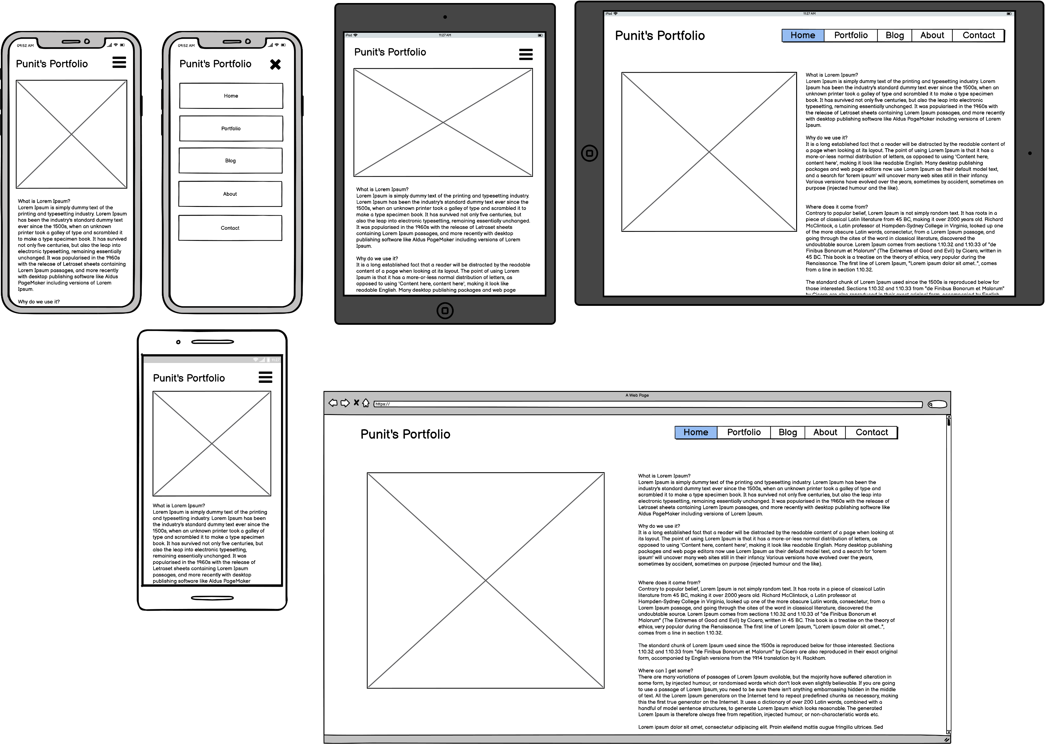
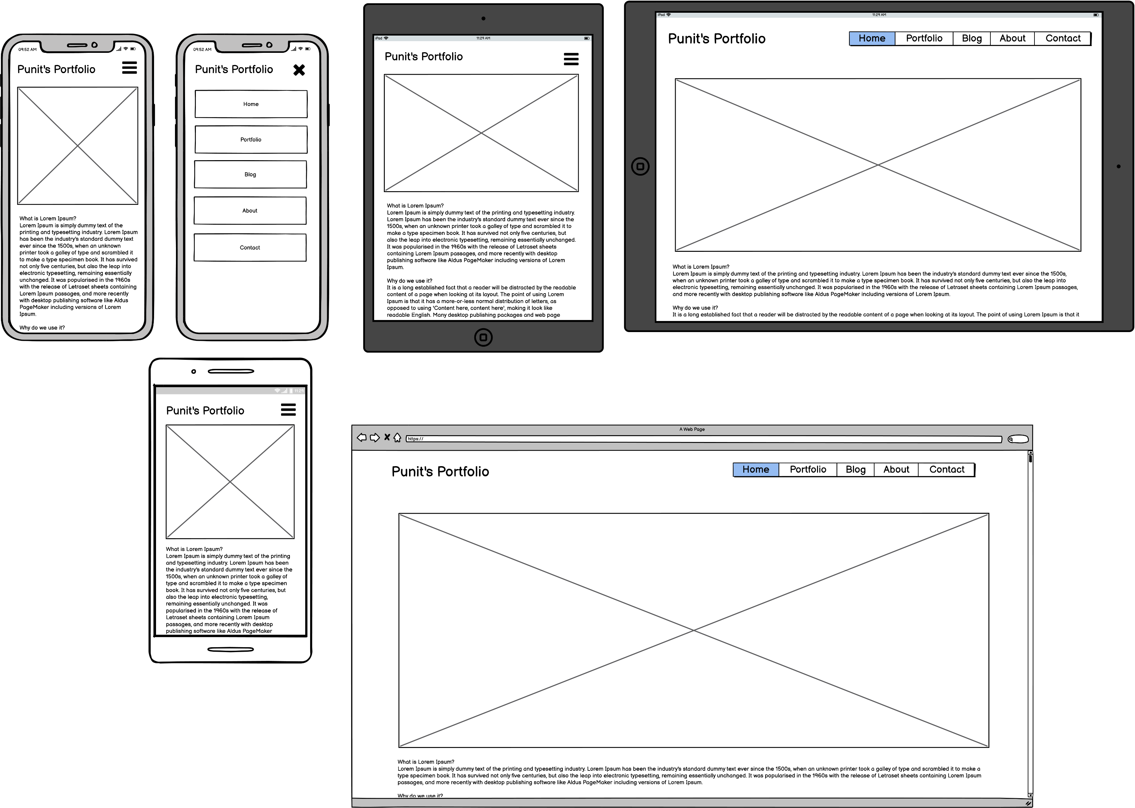
WireFrames

Slide 6
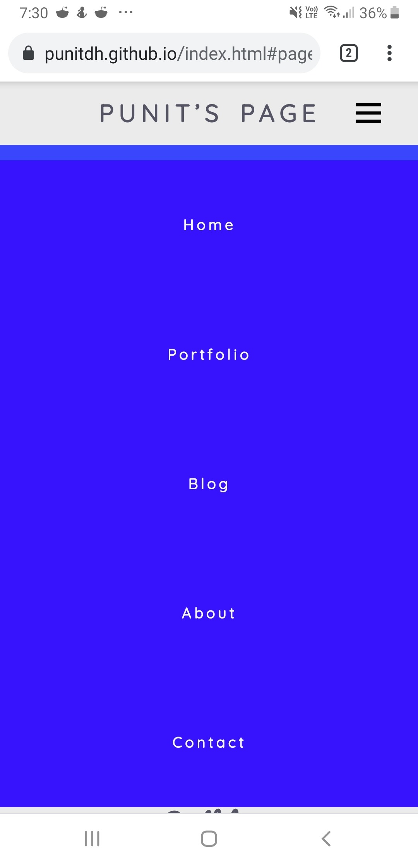
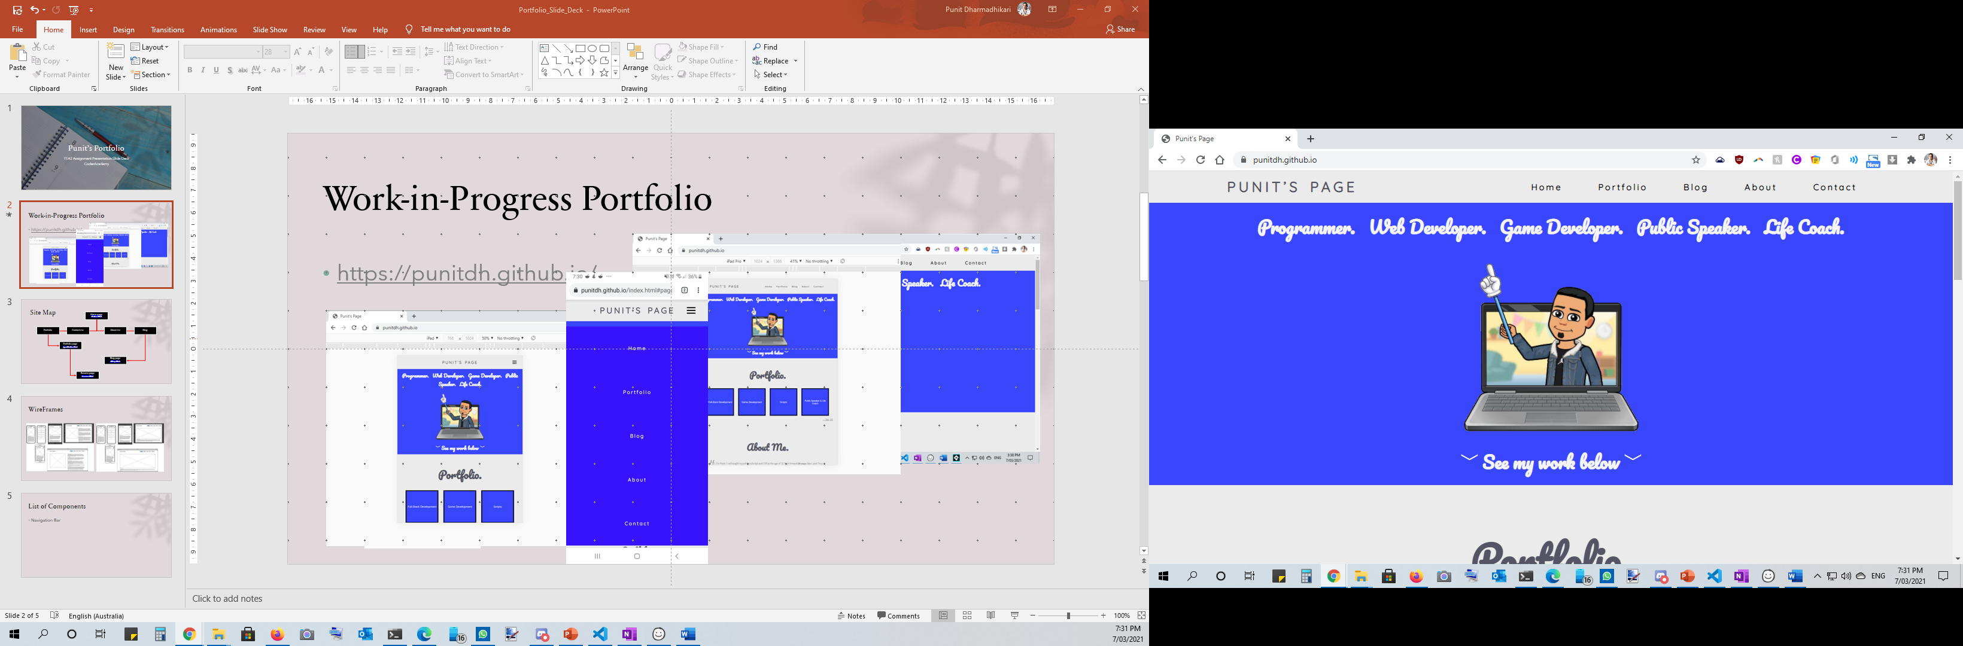
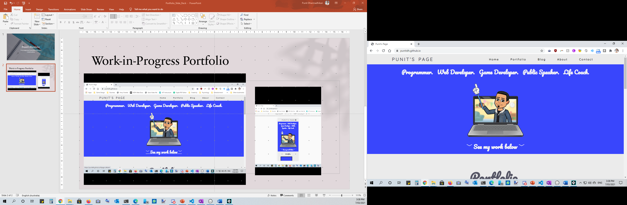
List of Components
Navigation Bar
Graphic
Mouse-over Box Buttons
Footer

Slide 7
A Walkthrough of the Website and its Features

